Slide 1


Grocery Store Analysis
Using SQL
Presented By:- Darshan Karwa

Slide 2
Hii, I am Darshan Karwa.
I have completed my B.Tech in Information Technology from Walchand Institute of Technology, Solapur.
I’m interested in Data Analysis because I love working with data, finding patterns, and solving real problems. I enjoy learning new things, improving my skills, and working on projects that make a difference.
Linkedin : https://www.linkedin.com/in/darshan-karwa-180974234/
GitHub : https://github.com/Darshhhhhhh
About me

Slide 3

Objective of Project
This project analyzes grocery sales data to understand customer demand across different areas and festive seasons.
- It helps retailers and wholesalers make smarter decisions for managing stock, planning offers, and improving overall sales and profits.

Slide 4
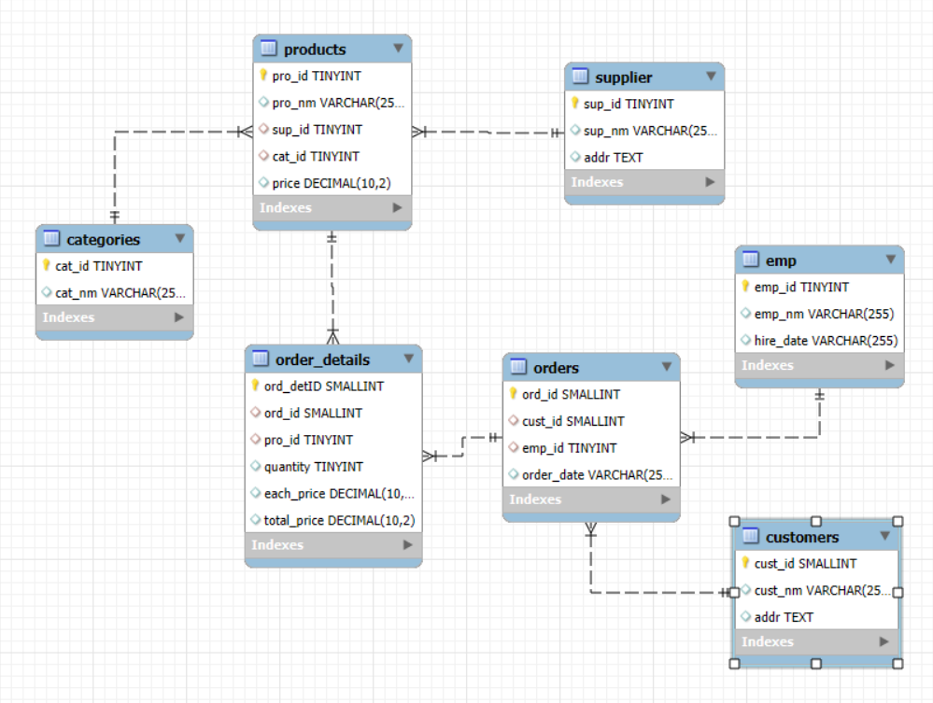
Entity Relationship Diagram (ERD)
Entity Relationship Diagram showing connections between Orders, Customers, Products, and Suppliers.

Slide 5
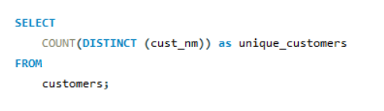

Data Insights & Findings
1. How many unique customers have placed orders?
Output :-
Out of 200 customers, 122 are repeat buyers, showing strong customer satisfaction and good store service.

Slide 6
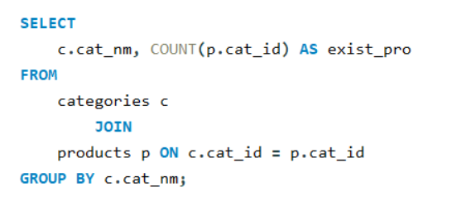
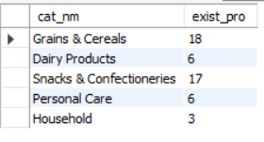
Data Insights & Findings
2. How many products exist in each category?
Output :-
Most of the products belong to Grains & Cereals and Snacks & Confectioneries, which shows these are the most stocked or in-demand categories, while the Household section has fewer products, suggesting limited variety or lower focus.

Slide 7
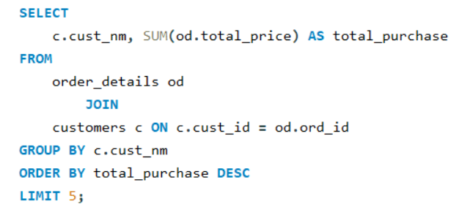
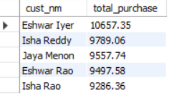
Data Insights & Findings
3. Who are the top 5 customers by total purchase amount?
Output :-
Eshwar Iyer is the top buyer, showing strong customer loyalty and purchasing power.
The top 5 customers are key contributors to overall sales, showing a strong and consistent purchase pattern.

Slide 8
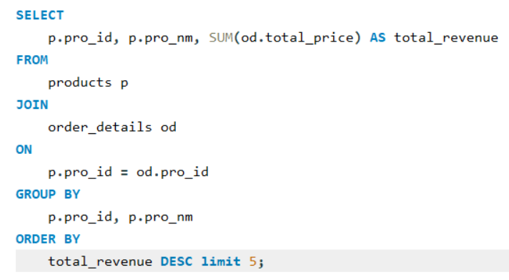
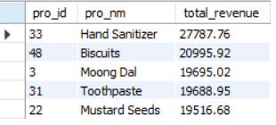
Data Insights & Findings
4. What is the total revenue generated by each product?
Output :-
Hand Sanitizer is the highest revenue-generating product, indicating strong sales and customer demand.
Other top products show consistent contribution across different categories.

Slide 9
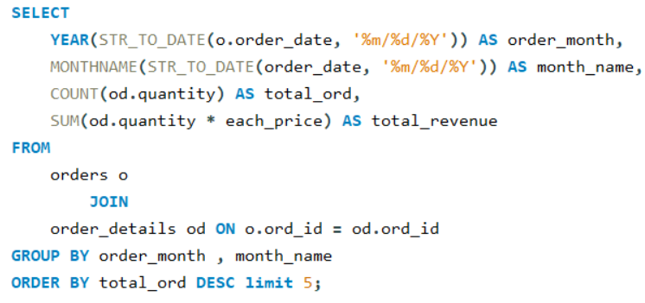
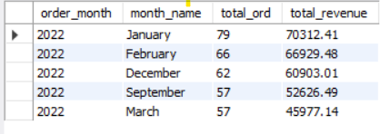
Data Insights & Findings
5. What are the monthly trends in order volume and revenue?
Output :-
January has the highest orders and revenue, showing peak sales season.
Sales remain strong in February and December, likely due to festive demand.

Slide 10
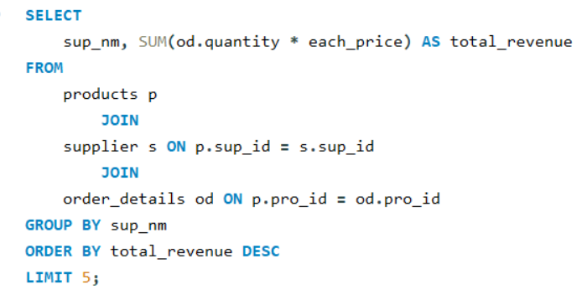
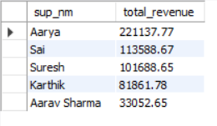
Data Insights & Findings
6. Which suppliers contribute the most to total product sales (by revenue)?
Output :-
Aarya is the leading supplier with the highest sales contribution, making them a key partner in overall revenue generation.

Slide 11
Business insights
🧍‍♂️ Customer Loyalty : -
Out of 200 customers, 122 are repeat buyers, showing strong satisfaction and trust in the store.
🛒 Product Focus : -
Most products belong to Grains & Cereals and Snacks, indicating a focus on essential and fast-moving items.
💰 Revenue Insights : -
A few top customers and best-selling products contribute the most revenue — potential for loyalty programs and targeted offers.
📅 Sales Trend : -
Higher sales during festival months highlight the importance of seasonal demand planning.
🤝 Supplier Impact : -
Major revenue comes from a few key suppliers — strengthening these partnerships can boost consistency and profit.

Slide 12
Experience and Challenges
Experience : -
Developed a strong understanding of connecting multiple tables using JOIN operations.
Built confidence in analyzing data and deriving meaningful business insights.
Gained hands-on experience in importing and managing large CSV datasets within databases.
Challenges : -
Experienced challenges in cleaning and aligning data across multiple tables.
Faced difficulties in building complex SQL queries, but significantly improved through consistent practice

Slide 13
Conclusion
This project helped identify key business insights such as customer loyalty, product performance, and supplier contribution.
The analysis highlights that maintaining essential product categories, focusing on high-value customers, and planning for festive demand can lead to better decision-making and profitability.
This project shows how SQL can turn raw data into real business insights that support smarter decisions.

Slide 14


Slide 15


